Slide 1

AY2026 Semester 2
C372
Payment Technologies
Lecturer’s Name:
Lecturer’s Email:
Module Chair’s Name: Magdalene Lim
Module Chair’s Email: magdalene_lim@rp.edu.sg

Slide 2
Agenda
About the Module
Class Timing
Lesson Mode
Attendance Policy
What Happens if I’m Absent?
Assessment & Guidelines
Academic Integrity
Tools & Platforms
Getting Help

Slide 3
About This Module
This module introduces students to a variety of payment technologies and systems, with a focus on their application and integration within web-based environments. Students will design and develop a web application that incorporates front-end and/or back-end payment modules. This process includes working with various payment application programming interfaces (APIs) to enable secure and efficient payment transactions.
A foundational understanding of the financial ecosystem, financial regulations, web application development, the software development life cycle, and database systems is assumed. Such knowledge may be acquired through modules like C368 Financial Ecosystems, C369 Financial Technologies, C237 Software Application Development, C206 Software Development Process, and C207 Database Systems.

Slide 4
About This Module
How Money & Code Connect (Foundations & Architecture)
Building Backends & Industry Insights
Making Transactions Happen (Integration & Payment Processing)
Trust, Safety, & Money Management (Security, Risk, & Operations)
Local Context & Final Settlements

Slide 5
Class Timing
This is a FOUR Modular-Credit (MC) Module.
There are TWO 2-hour lessons every week.
  Monday & Tuesday
  Wednesday & Thursday
Same timing and location for both lesson days
Check your timetable

Slide 6
Lesson Mode
*FA is in the form of a graded assignment(GA)
**Accurate as of 5 Oct 2026, some adjustments may be made
Week | Lesson |  |  |  | Remarks
 | No. | Mode | No. | Mode
1 | 1 | F2F | 2 | F2F | Learning Memo 1 Release
2 | 3 | F2F | 4 | F2F | FA* Release
3 | 5 | F2F | 6 | F2F
4 | 7 | AEL | 8 | F2F | FA Milestone 1 Submission
5 | 9 | AEL | 10 | AEL | Singapore Fintech Fest Week CA1 SA3 Submission Week
6 | 11 | F2F | 12 | F2F
7 | 13 | F2F | 14 | F2F | FA Milestone 2 Submission
8 | 15 | F2F | 16 | F2F | OH2027 (7 – 9 Jan) Learning Memo 2 Release
9 | 17 | F2F | 18 | F2F | CA2 SA3 Submission Week
10 | 19 | F2F | 20 | F2F
11 | 21 | F2F | 22 | F2F | FA Final SA3 Submission Week
12 | 23 | F2F | 24 | F2F | FA Presentation Week
13 | 25 | AEL | 26 | AEL

Slide 7
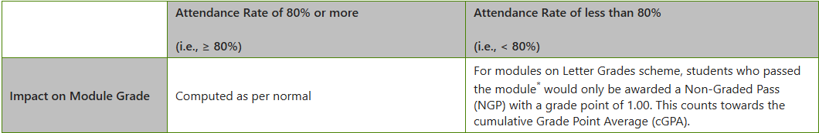
Attendance Policy
Attendance Statuses | Face-to-face | Asynchronous e-learning Lessons
Present | Students who arrived before end of grace period (10 mins) and stayed till end of lesson | Students who completed learning materials within deadline
Partial | Students who: Arrived after grace period (10 mins) and/or Missed more than 10 minutes of the lesson, without lecturer’s permission | N.A.
Absent | Not present at all | Students who did not complete learning materials within deadline
Par
Refer to the relevant section in the student handbook here: Student Handbook - Absenteeism (sharepoint.com)

Slide 8
Absent from Class?
Submit your LOA for approval via SNAPP
Check with lecturers on the submission for the lesson and submit the deliverables
If you are absent for lessons:
  Deliverables
    If you are absent with approved Letter-of-Absent (LOA), you will be given extension of 3 days for your deliverable submission
  Graded Quizzes
    If you are absent with approved Letter-of-Absent (LOA), you will need to inform your lecturer to schedule for a makeup session
Failure to turn up for the make-up will result in 0 mark for respective CA grade and will impact your module grade.

Slide 9
Assessment Guidelines
Component | Weighting (%) | Assessment Requirements / Submissions
Continuous Assessment 1 (CA1)* | 10 | Complete: Kahoot quiz Submit via SA3.0: Final PetCareApp code for CA1, documentation, AI Interaction Journal and app walkthrough video
Continuous Assessment 2 (CA2)* | 20 | Complete: Kahoot quiz Submit via SA3.0: Final PetCareApp code for CA2, documentation, AI Interaction Journal and app walkthrough video
Final Assessment (FA) | 40 | Submit via SA3.0: Final FA graded assignment code, documentation, AI Interaction Journal and app walkthrough video
Self-Directed and Collaborative Learning (SDCL) | 15 | Certificates upload to POLITEMALL Learning Memo 1 and 2 to POLITEMALL Weekly worksheets upload to POLITEMALL
Communication Skills (CS) part of FA | 15 | -
Total | 100
Refer to student handbook for more information:
Student Handbook - 01.Academic_Information (sharepoint.com)

Slide 10
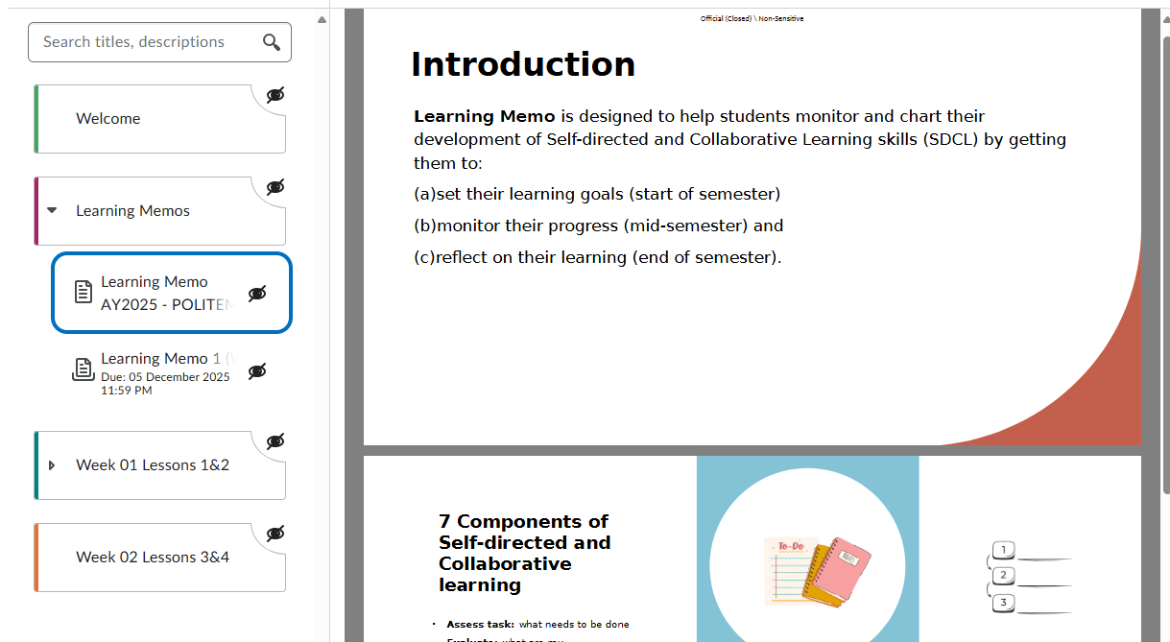
SDCL Learning Memo
Learning Memo is designed to help you monitor and chart your development of Self-directed and Collaborative Learning skills (SDCL) by getting you to:
  set your learning goals (start of semester)
  monitor your progress (mid-semester) and
  reflect on your learning (end of semester).
Learning Memo 1
  Weeks 1–3: Answer questions 1 to 3.
  Weeks 4–7: Answer questions 4 to 8
Learning Memo 2
  Weeks 8-13: Answer questions 1 to 4
Note: You may resubmit your responses at any time between Weeks 1 and 7 for learning memo 1 and any time between Weeks 8 and 13 for learning memo 2.

Slide 11
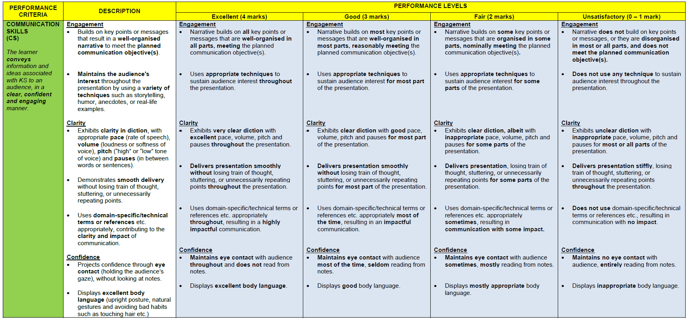
Communication Skills (CS) Rubrics

Slide 12
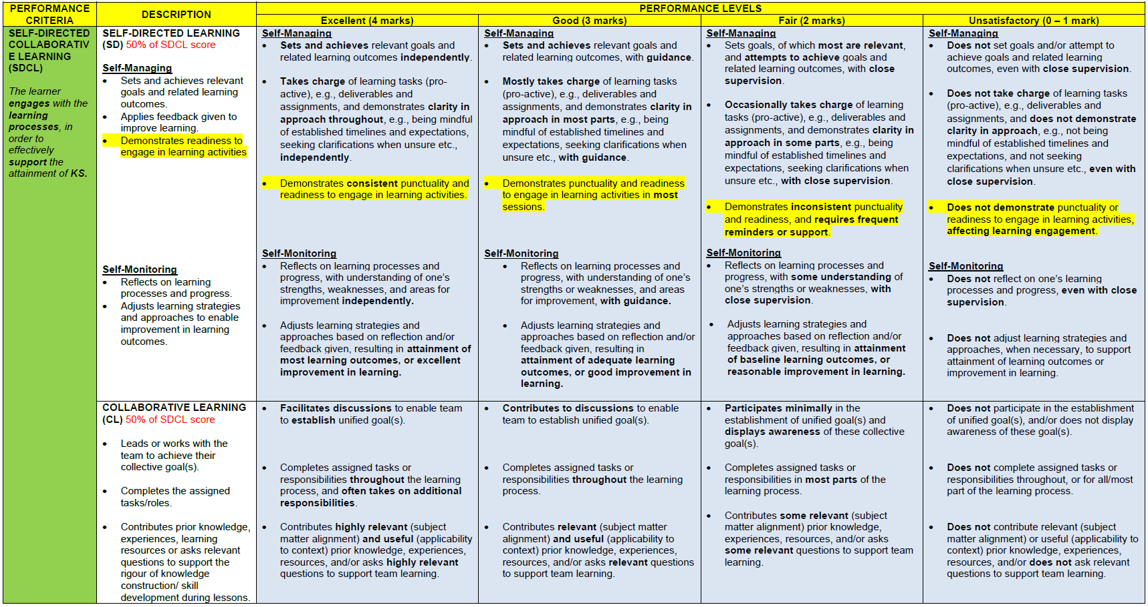
Self-directed and Collaborative Learning (SDCL) Rubrics

Slide 13
Plagiarism & Academic Dishonesty
Warning:
Any student caught infringing any of the Assessment Rules and Regulations in any way is liable to disciplinary action including, but not limited to, an outright failure for the Summative Assessment and downgrading of the Module Grade. More severe penalties which can be imposed on a student caught cheating in a summative assessment include suspension or even dismissal from the Polytechnic.
Student Handbook - Summative_assessment_rules_and_regulations (sharepoint.com)

Slide 14


Using AI Tool for Learning
Official (Closed) \ Sensitive Normal
As a learner in RP, you are:
Allowed to use AI tools for learning purposes
Accountable for
  Using such tools in an ethical and responsible manner
  Evaluating the accuracy, credibility and relevance of the response generated by the AI tool
  Understanding the types of tasks that the AI tool is appropriate for, the limitations of the tool and how the AI-generated response could aid in your learning.*
*Consult your lecturers for advice on the use of such tools when in doubt.

Slide 15
Using AI Tool for Learning
Official (Closed) \ Sensitive Normal
Examples of appropriate use of AI tools for learning:
Engage in self-directed learning by using the AI tool to:
  Generate responses to questions that you may have and verifying the
appropriateness and validity of these responses through further research
  Generate Q&As or critique draft work, and critically assessing the responses provided by the tool
Using the AI tool together with other learning resources to gain a deeper
understanding of the subject matter

Slide 16
Using AI Tool in Assessment
Official (Closed) \ Sensitive Normal
You are expected to:
Submit authentic work for assessment that represents your academic abilities.
Understand and comply with whether AI use is permitted for each assessment, and what constitutes authorised and unauthorised use of AI.
Consult your lecturer if you are in doubt.
The unauthorised use of AI to create content that is submitted as the learner’s
own work is considered plagiarism. Such an act constitutes academic
dishonesty and is a violation of RP’s Rules and Regulations pertaining to
academic integrity.

Slide 17
Using AI Tool in Assessment
Official (Closed) \ Sensitive Normal
If AI tools are permitted for an assessment, you must acknowledge their use in your submission by:
  Citing the AI tool(s) used;
  Providing the input prompt(s) and relevant response(s); and
  Explaining how and where the AI-generated content was used in your work.
Where required, you may also be asked to attend a Q&A session to:
  Explain how the AI-generated content influenced your work; and/or
  Verify the authenticity of your submission; and/or
  Provide additional materials (e.g., drafts of your original work) to determine the extent of your original contribution relative to AI-generated content; and/or
  Demonstrate your understanding of the AI-generated response(s).

Slide 18
Citing the Use of AI Tools
Official (Closed) \ Sensitive Normal
When to cite AI: When AI is used to generate content (e.g., ideas, explanations, images, audio, videos) that you directly use, adapt, or paraphrase in your final submission, you must cite it.
How to cite AI:
Reference list format: AI Company Name. (Year, Month Day). Title of chat [Description, e.g. Generative AI chat]. Tool name / model. URL of the chat | Example: OpenAI. (2025, January 15). What are the causes and effects of climate change [Generative AI chat]. ChatGPT. https://chatgpt.com/share/abc123xyz
In-text citation format: (AI Company Name, Year) or AI Company Name (Year) | Examples: OpenAI (2025) listed the causes of climate change as … Climate change amplifies environmental and social vulnerabilities, such as increased heat and flooding risks (OpenAI, 2025).
More info on APA style citation: https://apastyle.apa.org/blog/cite-generative-ai-references

Slide 19
Possible Limitations of AI Tools
Official (Closed) \ Sensitive Normal
AI tools may produce responses that:
Are inaccurate or biased
Are outdated
  AI tools are dependent on the data used to train the tool and may be unaware of recent developments
Are dependent on the quality of the input prompts
Do not include the source of the information
Lack creativity

Slide 20
Academic Integrity
Official (Closed) \ Sensitive Normal
Any student caught infringing any of the Assessment Rules and Regulations is liable to disciplinary action including, but not limited to, an outright failure for the assessment and downgrading of the Module Grade.
More severe penalties, including dismissal from the Polytechnic, will be imposed on a student caught cheating in an assessment.

Slide 21
In Summary
Official (Closed) \ Sensitive Normal
You…
…are accountable for the ethical and responsible use of AI tools
… must acknowledge the use of the AI tool(s) in your academic work if the AI tool(s) is/are allowed to be used
Be aware of the …
… limitations of AI tools
… consequences of submitting AI-generated work as your own work

Slide 22
IT Tools and Issues
POLITE Mall:
  Lesson Materials
EdTech Tools:
  MS Teams
  LinkedIn Learning, YouTube Videos

Slide 23
IT Issues (for students)
https://www.rp.edu.sg/docs/default-source/student-life-doc/self-help-configuration-guide.pdf
Students to email help-IT@rp.edu.sg, or call 66971500.

Slide 24
What to do if my lecturer is not in class?
If your lecturer is not in class 15 mins past your class starting time:
Contact the module team via MS Teams:
  Ms Magdalene Lim (magdalene_lim@rp.edu.sg)
  Mr Tok Nam Huat(tok_nam_huat@rp.edu.sg)
Everyone should remain in class while the module team looks into this matter, such as finding a replacement lecturer.
Do note that a make-up lesson will be conducted, if a lesson is not conducted on its stipulated date and time.

Slide 25
Thank you!

